Slide 1
Load and display 3D mesh
CS4610, Sp13
By Rui Wang

Slide 2
Overview
OBJ files
Perspective Projection
OpenGL Viewing(camera) Transform
Rotation and Translation

Slide 3
OBJ files
OBJ (or .OBJ) is a geometry definition file format first developed by Wavefront Technologies for its Advanced Visualizer animation package.

Slide 4
OBJ files Cont.
The OBJ file format is a simple data-format that represents 3D geometry alone — namely, the position of each vertex, the UV position of each texture coordinate vertex, normals, and the faces that make each polygon defined as a list of vertices, and texture vertices. Vertices are stored in a counter-clockwise order by default, making explicit declaration of normals unnecessary. OBJ coordinates have no units, thus OBJ files do not contain any scale information.

Slide 5
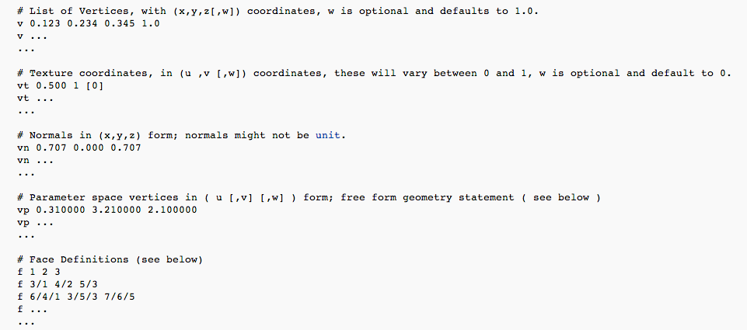
OBJ files cont.

Slide 6
LoadObj
Load an obj file
OBJMmodel * loadObj::Load(char* filename,OBJMmodel *pmodel)
Draw 3D model
OBJMmodel *loadObj::drawmodel(OBJMmodel *pmodel)

Slide 7
Perspective Projection
void gluPerspective(GLdouble fovy,
GLdouble aspect,
GLdouble zNear,
GLdouble zFar);
Fovy: Specifies the field of view angle, in degrees, in the y direction.
aspect: Specifies the aspect ratio that determines the field of view in the x direction. The aspect ratio is the ratio of x (width) to y (height).
zNear: Specifies the distance from the viewer to the near clipping plane (always positive).
zFar: Specifies the distance from the viewer to the far clipping plane (always positive).

Slide 8
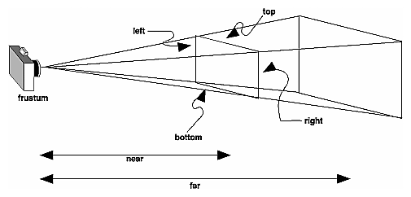
Perspective Projection

Slide 9
ViewingTransform
void gluLookAt( GLdouble eyeX, GLdouble eyeY, GLdouble eyeZ, GLdouble centerX, GLdouble centerY, GLdouble centerZ,
GLdouble upX, GLdouble upY, GLdouble upZ);
eyeX, eyeY, eyeZ
Specifies the position of the eye point.
centerX, centerY, centerZ
Specifies the position of the reference point.
upX, upY, upZ
Specifies the direction of the up vector.

Slide 10
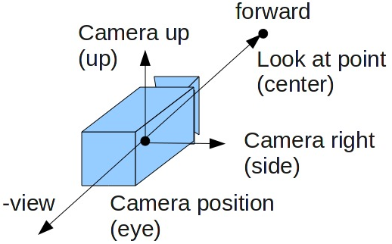
ViewingTransform

Slide 11
Rotation and Translation
void glRotated( GLdouble angle,
GLdouble x,
GLdouble y,
GLdouble z);
void glTranslated( GLdouble x,
GLdouble y,
GLdouble z);

Slide 12
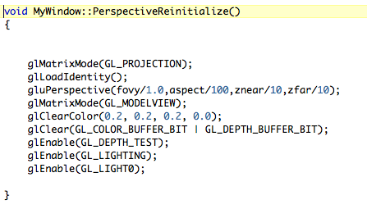
Example

